Slide 1
Introduction to OpenHarmony
Yutao Liu
Director, Huawei Dresden Research Center
OpenHarmony Concurrency & Coordination TSG Initial Member
Notes:
Good morning, everyone. I am Yutao, from Huawei Dresden Research Center. I am also one of the initial members of OpenHarmony Concurrency & Coordination TSG.
Welcome to the OpenHarmony Tutorial. I will first go through a brief introduction of OpenHarmony, from perspective of the trends, the technologies and ecosystem.

Slide 2

Connected, Intelligent World: Calls for New Operating Systems
Replacement for manually punched cards
Multi-tasking
Improved performance
Keyboard and mouse based UI
Emergence of the software industry
Touch-based UI
Portal of ecosystem
Empowering versatile industries with intelligence
Batch processing
Host
PC internet
Mobile internet
Connected, intelligent world
1956
1960s
1980s
2000s
2020s
First operating system
GM-NAA I/O
OS/360 (1964)
UNIX (1969)
Windows (1985)
Linux (1991)
iOS (2007)
Android (2008)
?
Notes:
Looking back over the past 70 years, operating systems have evolved with the growth of the information industry—from batch processing to mainframes, PCs, the internet, and mobile.
As the industry changed, so did operating systems. In the mainframe era, hardware was key; in the PC era, it was all about mouse and keyboard; and now in the mobile era, it's about tapping and swiping, with ecosystems becoming the focus.
Looking ahead, there's huge potential in a connected, smart world. This new era needs a new kind of operating system, and OpenHarmony is here to help power industries forward.

Slide 3

What is a Connected, Intelligent World?
Healthcare
Living Spaces
Making Health Computable, Bettering Quality of Life
Personalized Spaces with Novel Interactive Experiences
Food
Transportation
Data-driven Food Production for More Bountiful, Inclusive, and "Green" Diets
Smart, Low-carbon Transport Opens up the Mobile Third Space
Intelligent World 2030
Cities
Enterprises
New Digital Infrastructure Makes Cities More Human and Livable
New Productivity, New Production Models, New Level of Resilience
Energy
Digital trustworthiness
Intelligent, Green Energy for a Better Planet
Digital Trust
# of connections worldwide
General-purpose computing power (FP32)
AI computing power (FP16)
Cloud services as % of total enterprise application expenditure
Share of renewable energy in global electricity generation
200 bn
3.3 ZFLOPS, 10x
105 ZFLOPS, 500x
87%
50%
Notes:
By 2030, we predict there will be 200 billion connections worldwide. General-purpose computing power (FP32) will increase 10 times to 3.3 ZFLOPS, while AI computing power (FP16) will grow 500 times to 105 ZFLOPS. Intelligent vehicles will have 5,000 TOPS of computing power, cloud services will make up 87% of enterprise app spending, and renewables will supply over 50% of global electricity.

Slide 4







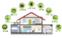




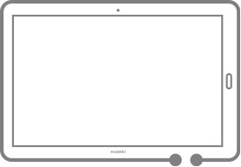








Three Major Changes in a Connected, Intelligent World
Connected, intelligent world:
Diversified and Immersive + Scenario-oriented + Ecosystem-oriented
Mobile internet: Media-rich
(1)Diversified
Immersive interaction
Entertainment
Augmented interaction
(Augmented human sense)
Computing
(Extension of human cognition)
Large
screen
Office
TWS
PC
Speaker
Smart home
(2)Scenario-oriented
Mobile phone
Watch
Tablet
Intelligent
cockpit
Sport and healthcare
xR
Travel
(3)Ecosystem-oriented
Notes:
We expect three big changes in the connected, intelligent world compared to the mobile internet era:
First, there will be way more types of devices, with tens of billions of connected devices.
Second, the way users interact with devices will shift from one-to-one to many-to-many. People will care more about experiences in different situations—like in transportation or at home—rather than just the device itself.
Third, lots of device makers, app developers, and service providers will come together to create a massive ecosystem.

Slide 5





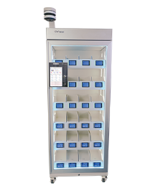



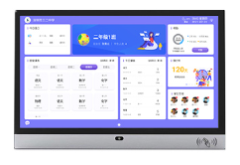



Empowering a Connected, Intelligent World with OpenHarmony
Unified ecosystem for apps and services
Third-party commercial releases & products
Ultimate experience with software-hardware-chip-cloud integration to support Huawei's high-quality products.
Empower a range of industries.
HUAWEI
Open Source Community & Third-party
OpenHarmony
Advanced OS base for a connected, intelligent world
Notes:
Harmony has three main pillars that support a connected, intelligent world:
OpenHarmony provides the core features for both Huawei's HarmonyOS and the OpenHarmony open-source community.
HarmonyOS, built on OpenHarmony, drives the success of Huawei devices.
The OpenHarmony open-source community helps power a variety of industries.

Slide 6
OpenHarmony: Vision, Design Philosophy and Architecture Characteristics
Building an OS foundation and ecosystem for
federated all-scenarios in a fully, connected world
Vision
Simplified Development, Consistent Experiences
Simplified development once, consistent experiences across multiple devices
Native Security,
Ecological Security,
Distributed, full-scenario security framework and a pure secured ecosystem
Architecture
Characteristics
Free Transitioning,
Intelligent Collaboration
Seamless and intelligent cross-device collaboration
Heterogeneity Concurrency,
Vertical Integration
Heterogeneity Concurrency and Vertical Integration for smooth experience
Decoupled Architecture, Elastic Deployment
Componentized and elastic decoupled architecture for versatile smart devices
Unified Ecosystem, Open source for win-win
Philosophy
Notes:
The vision of OpenHarmony is to create an operating system and ecosystem that connects everything in a fully integrated, smart world.
This is based on the architecture characteristics including simplified development and consistent experience for developers, built-in security, smooth transition between devices,
As well as more flexibility and scalability.
We believe in an open ecosystem where everyone can contribute and benefit. By working together, we can create something bigger and better for all.

Slide 7



One OS Kit for All: Serving a Broad Spectrum of Devices
Mobile phone
Unified architecture across different devices
Fast time to market
Low R&D costs
All-scenario collaboration and intelligence
Cross-device cooperation
Transparent task offloading
Open and unified ecosystem
Write once, run everywhere
A group of components
Assembly
Unified
architecture
Car
Dependency:
Component X
Component Y
...
Name
Function
Feature
RAM
ROM
API
Specification
Camera
Component X
Component Y
Component Z
...
A group of components
A group of components
OSKA (元OS™)
Watch
Watch
A group of components
A group of components
Notes:
OpenHarmony uses the architecture we called 元OS (which means OS kit for All) to adapt easily to different scenarios.
First, 元OS is a unified architecture, so we don’t need to re-compile everything for different situations. We just put together the necessary parts, which helps cut down maintenance costs.
Second, 元OS supports all-scenario synergy, meaning tasks can be shared across devices. This ensures smooth connections between devices.
Lastly, 元OS helps build a unified and open ecosystem where everything can work together.

Slide 8
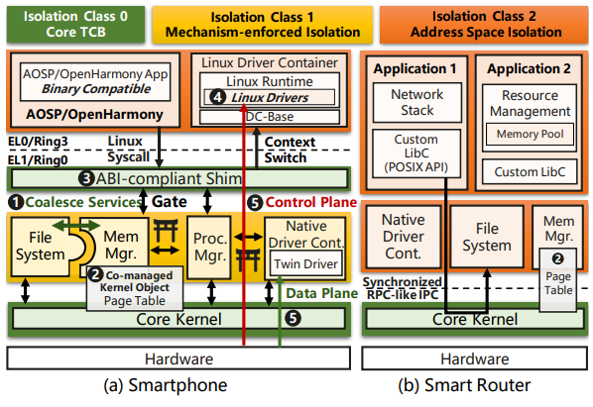
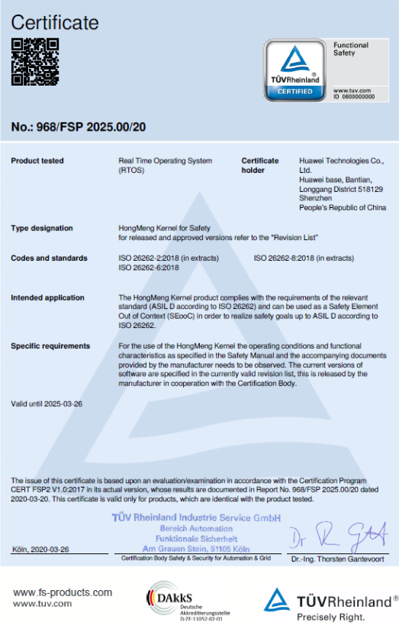
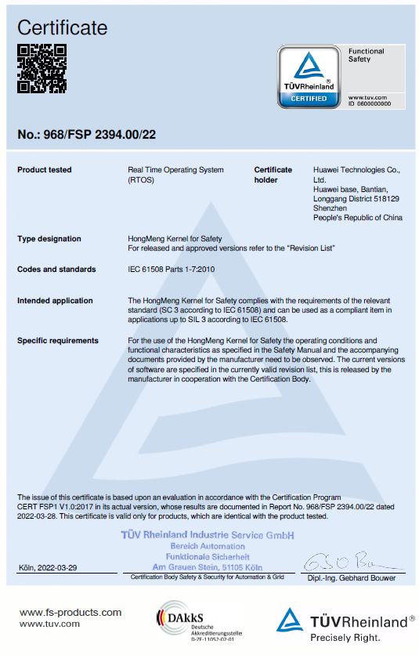
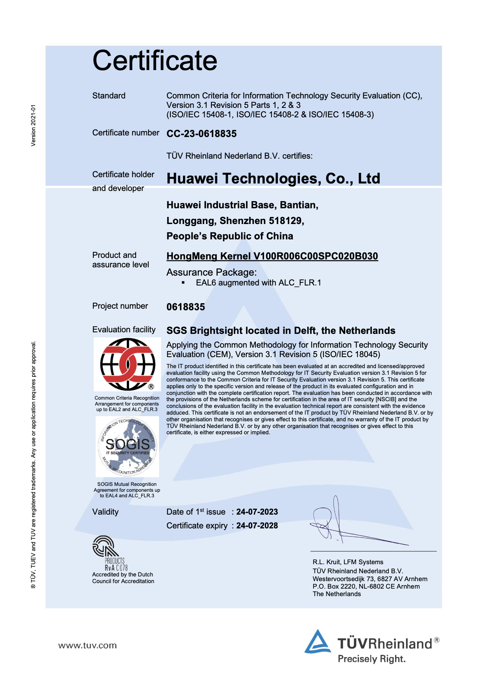
HongMeng Kernel: A Commercialized General-purpose Microkernel
Flexiblity
Recognized Security & Safety
Higher Performance
20%
Minimal microkernel with isolated, least-privileged OS services
Flexible composition to accommodate diverse scenarios
Linux API/ABI compatible
CC EAL 6+
ASIL-D
IEC 61508
20%+ higher performance than Linux in commercialized products
Chen, Haibo, et al. "Microkernel Goes General: Performance and Compatibility in the {HongMeng} Production Microkernel." 18th USENIX Symposium on Operating Systems Design and Implementation (OSDI 24). 2024.
Notes:
The underlying of OpenHarmony is HongMeng Kernel, which is a minimal microkernel with isolated least-privileged OS services. We have made it flexible enough to accommodate diverse scenarios. The security and safety is guaranteed by recognized certification of CC EAL 6+, ASIL-D and IEC 61508, and compared on Linux in commercialized products like smartphone, we can achieve higher performance. This work has been published in OSDI 2024.

Slide 9
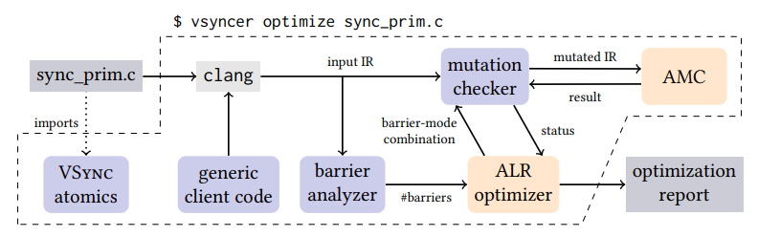
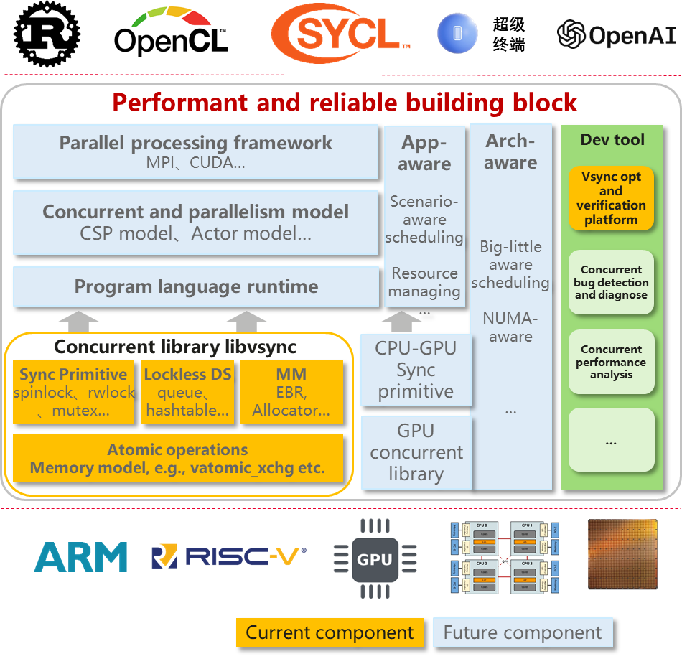
S4C: Safe and Scalable System Software Concurrency
libvsync open sourced in OpenHarmony
s4c: Safe and Scalable System Software Concurrency
Publications in top conferences:
VSync (ASPLOS‘21 Best Paper), CLoF (SOSP’21), BBQ (ATC‘22), BWoS (OSDI’23), AtoMig (ASPLOS‘23), Btrace (ASPLOS’25), etc.
Notes:
With the advent of the post-Moore era, processor hardware evolves from single-core to multi-core and from homogeneous to heterogeneous.
Therefore based on OpenHarmony we have set up the concurrency and coordination TSG, where we investigate and do research on safe and scalable system software concurrency based on formalized approaches like model checking and SMT. And we publish several papers on top conferences and open source the libvsync and vsync tool within OpenHarmony depository.

Slide 10
AI-native capabilities brings in-depth intelligent innovation
Applications and system entries
App
Dialog
Search
Recommendation
Vision
Haptics
…
Third-party apps can call OpenHarmony AI-native capabilities through AI-powered components and minor code modifications.
More and more native intelligent components are opened, bringing in-depth innovation and transformation to third-party apps.
Smart assistant
Enablement system
Natural interaction
Ultimate efficiency
Personal services
AI-powered components
AI-powered apps
AI-native Foundation
AI runtime
Data foundation
Intent framework
Notes:
OpenHarmony also has AI-native capabilities. It's not just about smart assistant apps—third-party apps can also tap into these AI features with just a few code tweaks.
By making AI components available, we’re helping third-party apps bring smarter, more innovative experiences.

Slide 11




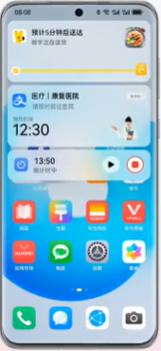
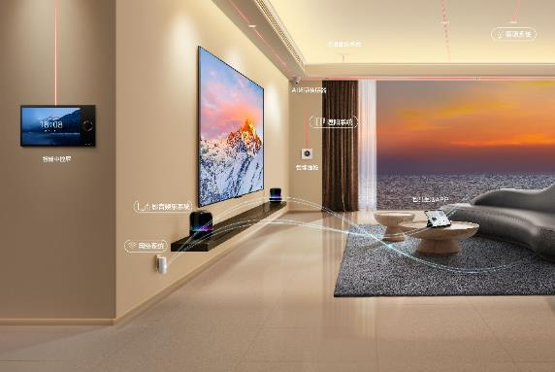

Secure by Design: Security Architecture with Multi-level Compartmentalization
Rich execution environment
(REE)
Trusted execution environment (TEE)
High-level security environment
EL0
Application & framework
Cloud service
Trusted applications
(Huawei)
Trusted applications
(Third-party)
Security services
(Authentication)
Kernel security
Open TEE capabilities
EL1
Threat detection
Permission control
Anti-exploitation
Enhanced security base for complementation and collaboration
iTrustee framework
System security
(MSP)
Hypervisor
EL2
Kernel integrity protection HKIP
Security microkernel
EL3
Trusted firmware
Hierarchical security of connected devices, device-device complementation, and device-cloud synergy
Chip security
Boot root of trust
Computing root of trust
Storage root of trust
Notes:
OpenHarmony's security setup is built to keep everything safe—whether it’s the REE, TEE, the software environment, or the chip itself.
In the connected, intelligent world, security and privacy will cover every part of the system. Thanks to the security collaboration mechanism, devices can work together with other devices and the cloud to fix security gaps and rebuild digital trust across the whole ecosystem.

Slide 12
Cangjie：A Programming Language Oriented to Full-scenario Intelligence
High Performance
Strong Security
Full-concurrency GC in terminal scenarios, smoother application threads and faster response. Lightweight threads provide better concurrency performance and less overhead.
Security DNA is integrated into language design, helping developers focus on business logic without spending too much energy on defensive programming.
Intelligence
All Scenarios
Embedded AgentDSL programming framework, organic integration of natural language and programming language
Lightweight and scalable runtime, modular and layered design, supporting domain-oriented declarative development.
Notes:
In OpenHarmony, there's also a Cangjie programming language designed for full-scenario intelligence.
It provides high performance, thanks to full-concurrency garbage collection and lightweight threads. Plus, it has security DNA built right into the language design, an embedded agentDSL for smart features, and a lightweight, scalable runtime that works across all kinds of scenarios.

Slide 13
OpenHarmony: Fastest-Growing Open-Source OS Community for Devices
70+
Organization Contributor
8200+
Contributors
120+ million
Code lines
1030+
Software and hardware products
Notes:
OpenHarmony is the fastest growing open source OS community for devices, with 70+ organization contributors, more than 8200 contributors, 120+ million code lines, and 1030+ software and hardware products.

Slide 14

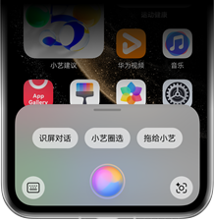



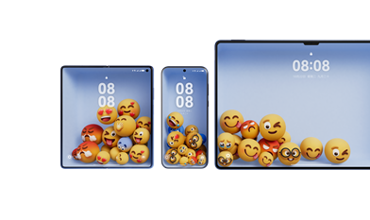


Huawei builds HarmonyOS NEXT based on OpenHarmony
Secure at its core
Smoother than ever
Native intelligence
Pure apps
Privacy protection
More knowledgeable
Memory & perception
30%
56 min
100%
7 types
smoother
longer battery life
Trillion-level
23 categories
from trusted sources
of privacy data now restricted
Secure access to images, contacts, files, etc.
tokens
of top scenarios
Inference & planning
Service distribution
100%
74%
90%
HarmonyOS Intelligence
Intelligent Celia for all your queries
300+
code signing
fewer permission pop-ups
(vs. iOS 18)
Success rate
key services
Privacy and security at your beck and call
Ark Engine for unprecedented smoothness
Celia for intelligence across the board
Born to be exquisite
Native connectivity
Harmonious look and feel
Innovative new interactions
Seamlessly connected at all times
Personalized fun
3x
4x
20%
faster connections
more connections
less power consumed
All-new DSoftBus
Notes:
In 2024, we launched HarmonyOS NEXT, the newest version of our native HarmonyOS. Built on the OpenHarmony open-source platform, it brings major improvements in areas like the kernel, file system, interconnectivity, database, programming language, compiler, framework, IDE, security, graphics, multimedia, and AI. These updates highlight our push to create a fully independent and controllable OS.
Also known as HarmonyOS 5, this is the biggest upgrade since HarmonyOS started. It completely changes the user experience with better security, smoother performance, smarter features, and a more polished feel.

Slide 15
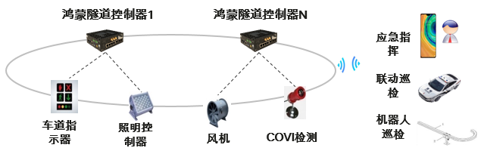



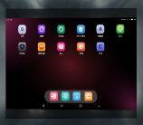









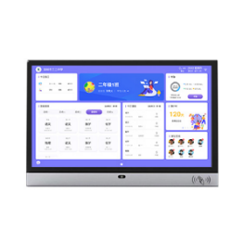



1030+ Software and Hardware Products Across Key Sectors
Energy
Transportation
Industry
Finance
Mining and electric power terminals
Smart tunnels
Drones and industrial terminals
Financial terminals
Cloud
Data is migrated to the cloud to generate gas reports and calibration work orders.
Automatic data reading and comparison
Automatic data panel
Healthcare
Education
Government
Smart medicine cabinets
Harmony classroom
e-Government terminals
More…
Notes:
Aside from the community, OpenHarmony's use in commercial products is a big win. Right now, it's powering over 1,030 commercial software and hardware products across sectors like energy, industry, finance, transportation, healthcare, education, and government. Its success in these products shows how OpenHarmony shines in areas like architecture, usability, stability, performance, and energy efficiency.

Slide 16













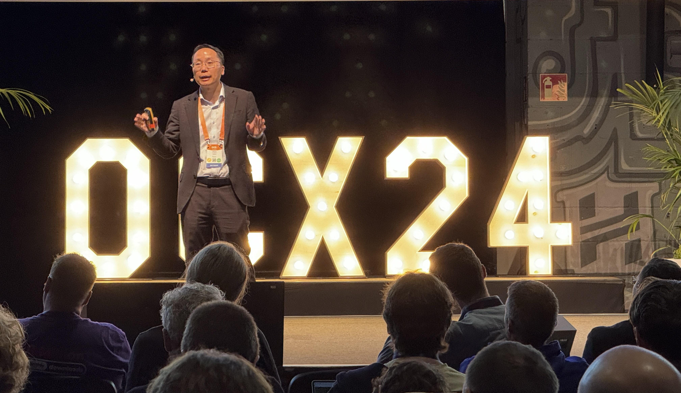

World Class Cross-Foundation Open Source Collaboration
Specification Developed following OpenAtom Specification Process
IP Pipeline
Applications
Frameworks
Specification Superset of OpenHarmony Specifications
Developed following Eclipse Specification Process
System Services
Driver Subsystem
Swappable Kernel
Distribution OpenHarmony compatible
Distribution Oniro & OpenHarmony compatible
Open specifications to serve devices in multiple domains & regions to be truly compatible
Oniro Specifications are based on OpenHarmony Specifications to ensure compatibility and interoperability across all regions and across hardware of different types, from graphic rich mobile devices to IoT devices.
Notes:
OpenHarmony is expanding globally at a fast pace. In 2023, Eclipse, Europe's biggest open-source organization, teamed up with the OpenAtom Foundation and launched Oniro OS, an open-source project based on OpenHarmony. Mike Milinkovic, Executive Director of Eclipse, said, "Oniro OS will offer a truly community-driven open-source solution."
Both projects are built on the same OpenHarmony Specification, as outlined in their partnership. This deal ensures that OpenHarmony is compatible and works smoothly across different regions and hardware, from mobile devices with rich graphics to IoT gateways.

Slide 17

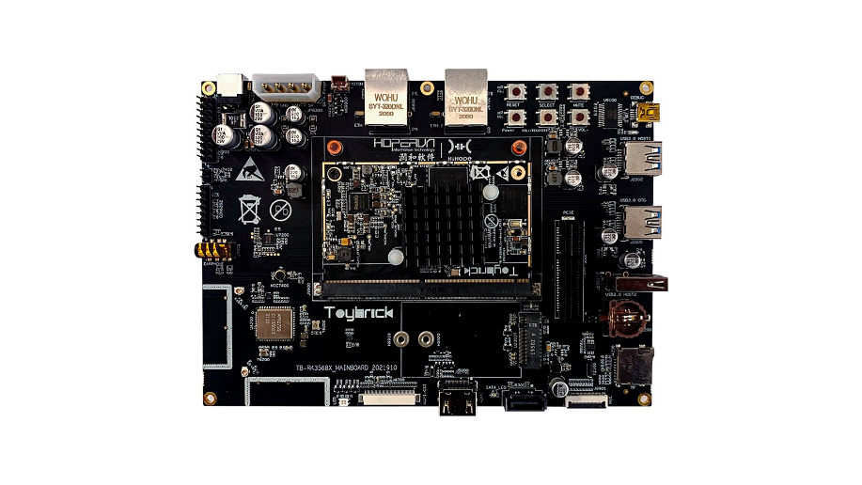




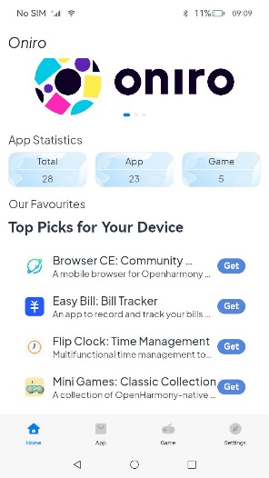

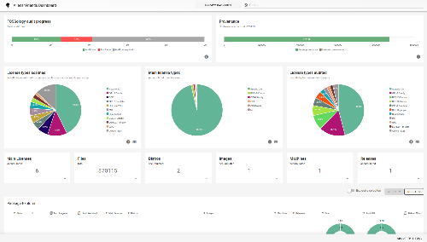
Eclipse Foundation Oniro Addition & Innovation Highlights
The European open source phone for innovators
Empowering IoT with Eclipse Kanto integration
Continuous IP compliance workflow with custom-built toolchain
App store with open source mobile apps
Cross-platform development using React Native framework
Web rendering engine in Rust with WebGL & WebGPU support
Open, flexible IDE for developers based on Eclipse Theia
Privacy-first, fully open source
Notes:
Oniro aims to establish a fully open-source smartphone, built in Europe, tailored for developers, innovators, and privacy-conscious users.
Including the Eclipse Kanto empowering edge devices, the custom-built toolchain to support intellectual property compliance, app store with open source mobile apps, availability ofr React Native to support cross-platform development, Servo integration to support lightweight and efficient rust-based web rendering, and flexible IDE based on Eclipse Theia.

Slide 18
Thank You!
Notes:
Thank you

